Slide 1

Mathematical modelling for vaccine-preventable diseases
Dynamic models lecture 3
Stochastic simulation
Andrew J K Conlan
University of Cambridge
ajkc2@cam.ac.uk
Notes:
Introduce who we are

Slide 2

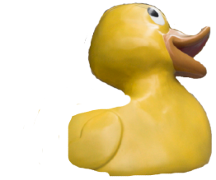
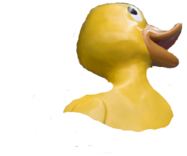

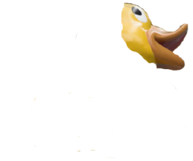

Deterministic Population Models
Easy to “solve” numerically and sometimes analytically
Under certain limits provide a “good enough” description of the dynamics of natural populations …
Population is represented by real
numbers which change continuously

Slide 3
The importance of being discrete…
Populations are more naturally
represented by integers
Changes in populations occur
due to discrete events
Death
Natural populations suffer local (and global) extinctions
Birth

Slide 4

…and stochastic
Biological populations exhibit large amounts of variability between individuals. This complexity generates population dynamics that are intrinsically stochastic.
From empirical data we can typically estimate population averages for the rate of biological processes.
Stochastic dynamics can emerge just from the uncertainty in the timing of events for individuals.
Svetlana Pankratova and PingPing
http://www.guinnessworldrecords.com/

Slide 5
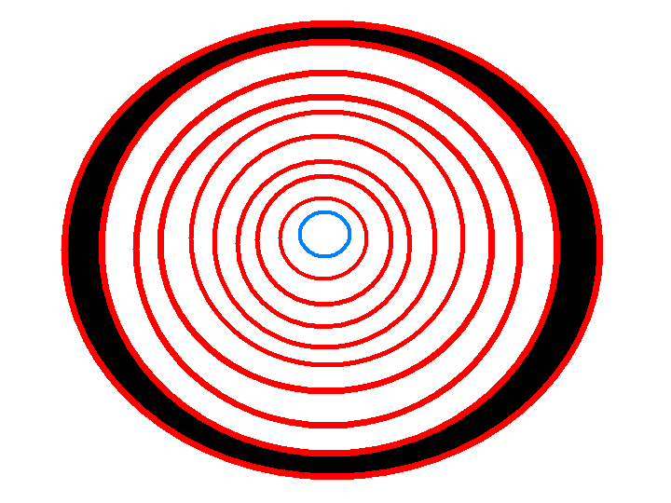
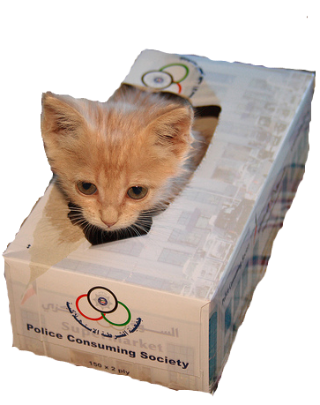
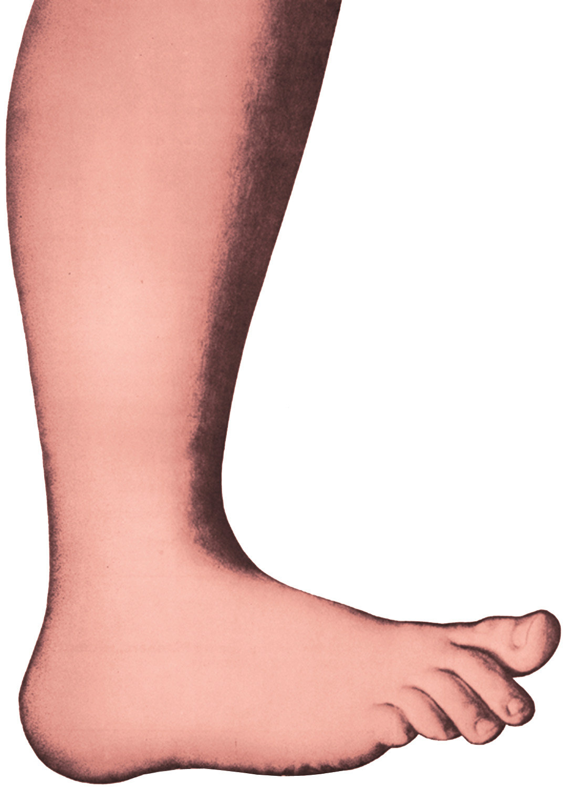
Sources of stochasticity
Stochastic processes are often characterised in terms of the:
Process: Systematic (deterministic) changes
Noise: Random fluctuations
Demographic Stochasticity
Intrinsic uncertainty in the timing of events
When processes occur at fixed rates, but the
time between events is random
Extra-demographic Stochasticity (environmental)
Variation in the rate that ``events’’ occur
Can treat parameters of model as random variables

Slide 6
Defining a stochastic model
Many different implementations, suitable in different contexts. To model
demographic stochasticity we choose to use continuous-time Markov chains.
Describe populations by integers (whole numbers) or state variables
State variables change due to events
Events occur randomly according to fixed rates (probabilities per unit time)
Model is defined in terms of these events and the rates at which they occur:
Event Effect Probability (per unit time)
Birth N -> N + 1 μ N
Death N -> N – 1 v N
What impact does demographic stochasticity have on population dynamics?

Slide 7
Constant Births Model
Consider the simplest possible population process, one event (birth) occurring at a fixed probability per unit time (B).
One state variable – Population size
Probability of birth occurring in a small interval of time Δt
Deterministic Representation

Slide 8
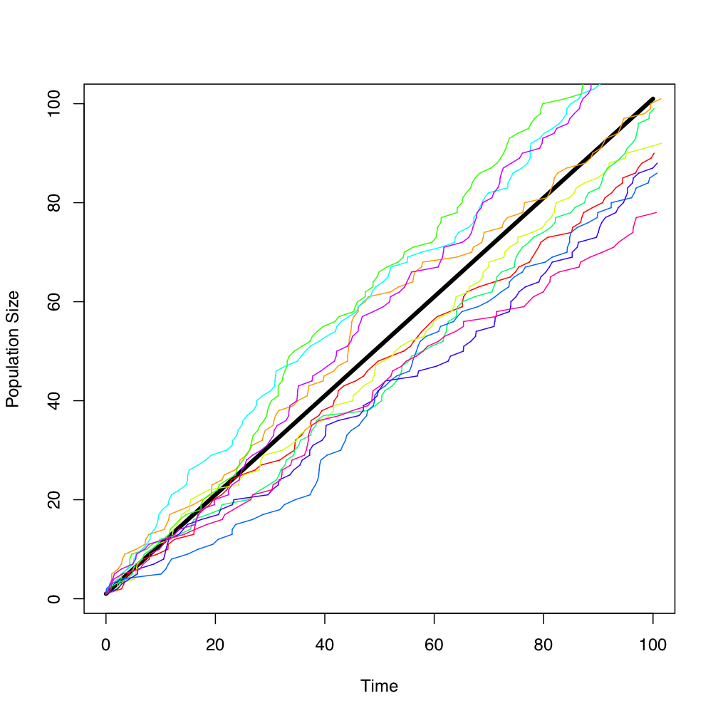
Simple Birth Model
Realisations of the stochastic model fluctuate around the deterministic growth curve
The deterministic solution approximates the ensemble average

Slide 9
Simulating a deterministic model
For a deterministic model we can calculate how variables change in a small time step (δt):
To simulate we just repeatedly step forward δt updating the variables of the model

Slide 10
Simulating a stochastic process
In a stochastic model an event may, or may not occur in δt
Can calculate probability of an event occurring:
And toss a coin at each step…
“Explicit τ leap”
no event
Providing
0
1
Slow, can do much better!

Slide 11
Simulating a stochastic process
Let τ be the inter-event time
Want to derive cumulative probability distribution for τ: q(τ < t)
Let p(τ) = probability of no event after τ units of time
Then the probability of no event occurring in a small interval δτ:
Probability that nothing
has happened up to
time τ
Probability that nothing
happens during time δτ
AND

Slide 12
Inter-event time distribution

Slide 13
Inter-event time distribution

Slide 14
Inter-event time distribution
Now, q(τ) is the (complementary) probability of an event happening within time t < τ
Time between events is exponentially distributed
Can simulate stochastic process by sampling time
between events from an exponential distribution

Slide 15

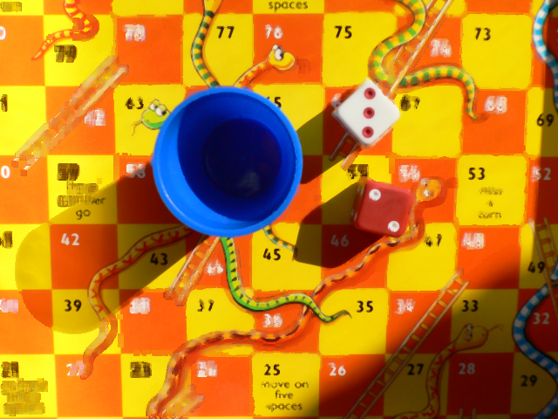
Where do we get our random numbers?
Computers are deterministic by design.
The same code should always give the
same answer whenever it’s executed.
Pseudo-random number generators are deterministic algorithms which produce numbers with the same statistical properties as true random numbers.

Slide 16
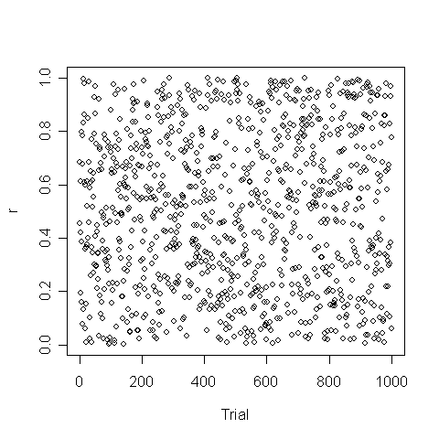
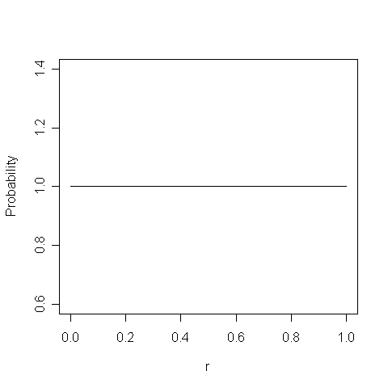
RNGs are designed to simulate random samples from a uniform
distribution (usually chosen to between 0 and 1).
x <- runif(1000)
cov(x[2:length(x)],x[1:(length(x)-1)])
mean(runif(1000))
var(runif(1000))
Mean
Variance
Covariance

Slide 17
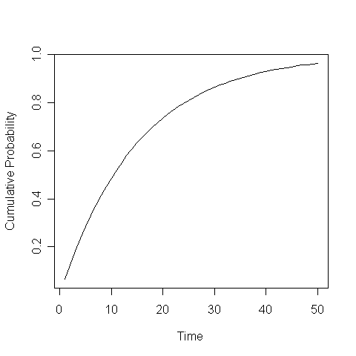
Sampling from a distribution
deltat = - log(runif(1))/B
deltat = rexp(1,B)
r = 0.85
Δt = 28
Cumulative Probability = P(Δt < t)

Slide 18
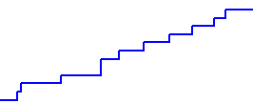
# Population Size
N = 1
# Time
t = 0
tmax = 100
# Parameters
B = 1.0
# Setup Graph for Output
plot(0,0,xlim=c(0,100),ylim=c(0,110),pch=NA)
# Main Loop
while(t < tmax)
{# Update time to after next event
t = t - log(runif(1))/B
# Update State Variable
N = N + 1
# Output
points(t,N,pch=20) }
Simulation Method
1. Generate a random number (r) between 0-1
2. Use to sample from exponential distribution to give time to next event
occurring:

Slide 19
Example II: Per Capita Birth Model
One state variable – Population size
Single Event - Birth, with per capita birth rate
Deterministic Representation
Can simulate process using the same inter-event time distribution than we found for simple birth model as rate of events r = μN is constant between steps of the model.

Slide 20
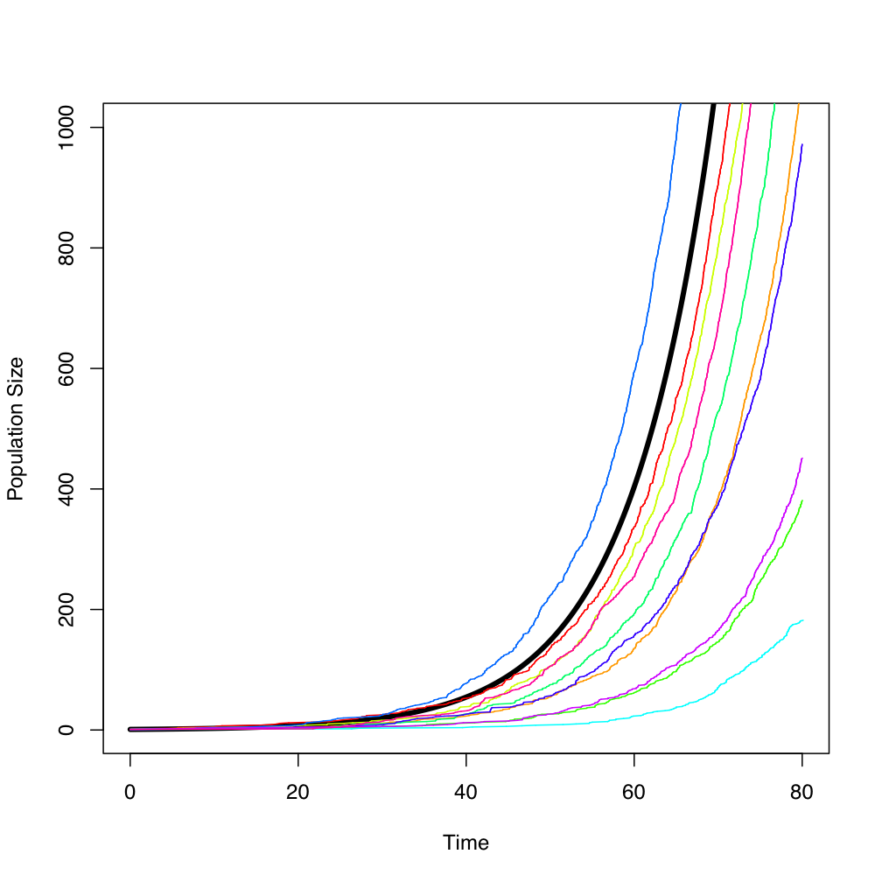
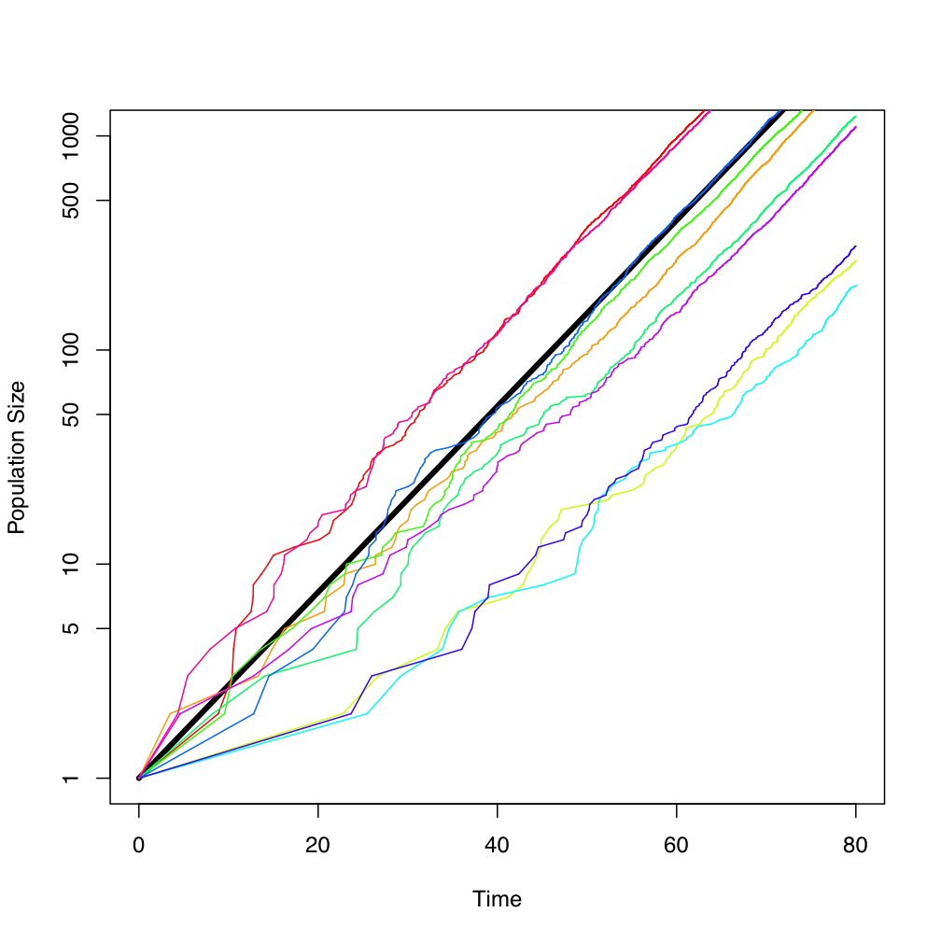
Per Capita Birth Model – Simulations
Variation between realisations is greatest at small population sizes
Need multiple replicates to quantify variation numerically

Slide 21
Markov Property
Providing the probability of events are time-independent and determined only by the current state then the model will satisfy the
memoryless condition:
and the time between events will be exponentially
distributed.

Slide 22
Example III: Logistic Growth
Two events: ``Birth’’ and ``Death’’
R₁
R₂
Define the total rate of events R_{TOTAL}
(probability of something happening per unit time)
R_{TOTAL} = R₁ + R₂ + ...

Slide 23
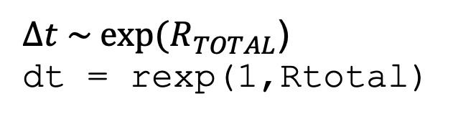
Stochastic Simulation Algorithm (SSA)
(Gillespie Method)
1. Generate a random number (p₁) between 0-1
2. Use to sample from exponential distribution (with rate parameter now R_{TOTAL}) to give time to next event occurring:
3. Generate a second random number (p₂) between 0-1
4. Use to select which event occurs next (based on their relative rates)
Equivalent to:
0
0.4
R₁
0.8
R_{TOTAL} = R₁ + R₂

Slide 24
Stochastic Simulation Algorithm
# State Vector (One variable)
N <- 1
# Parameters - (Birth Rate, Death Rate)
parameters <- c(1,100)
# Time Variable
t <- 0.0;tmax <- 80.0
# Setup Graph for Output
plot(0,0,xlim=c(0,tmax),ylim=c(0,150),pch=NA,xlab='Time',ylab='Population Size')
# Main Loop
while(t < tmax)
{ # Calculate rate of events
rate_vector <- logistic_rate(N,parameters)
# Update time
t = t + rexp(1,sum(rate_vector))
# Do the event
N <-logistic_event(N,rate_vector)
# Output
points(t,N,pch=20) }
logistic_rate <- function(state,p)
{ rate <- numeric(2)
# Probability of a birth
rate[1] <- p[1]*state
# Probability of a death
rate[2] <-(p[1]/p[2])*(state^2)
return(rate) }
logistic_event <- function(state_vector,rate)
{
total_rate <- sum(rate)
# Draw single random variate
x <- runif(1)
if(x*total_rate < rate[1])
{ # Birth
state_vector = state_vector + 1}
else
{ # Death
state_vector = state_vector - 1}
return(state_vector) }

Slide 25
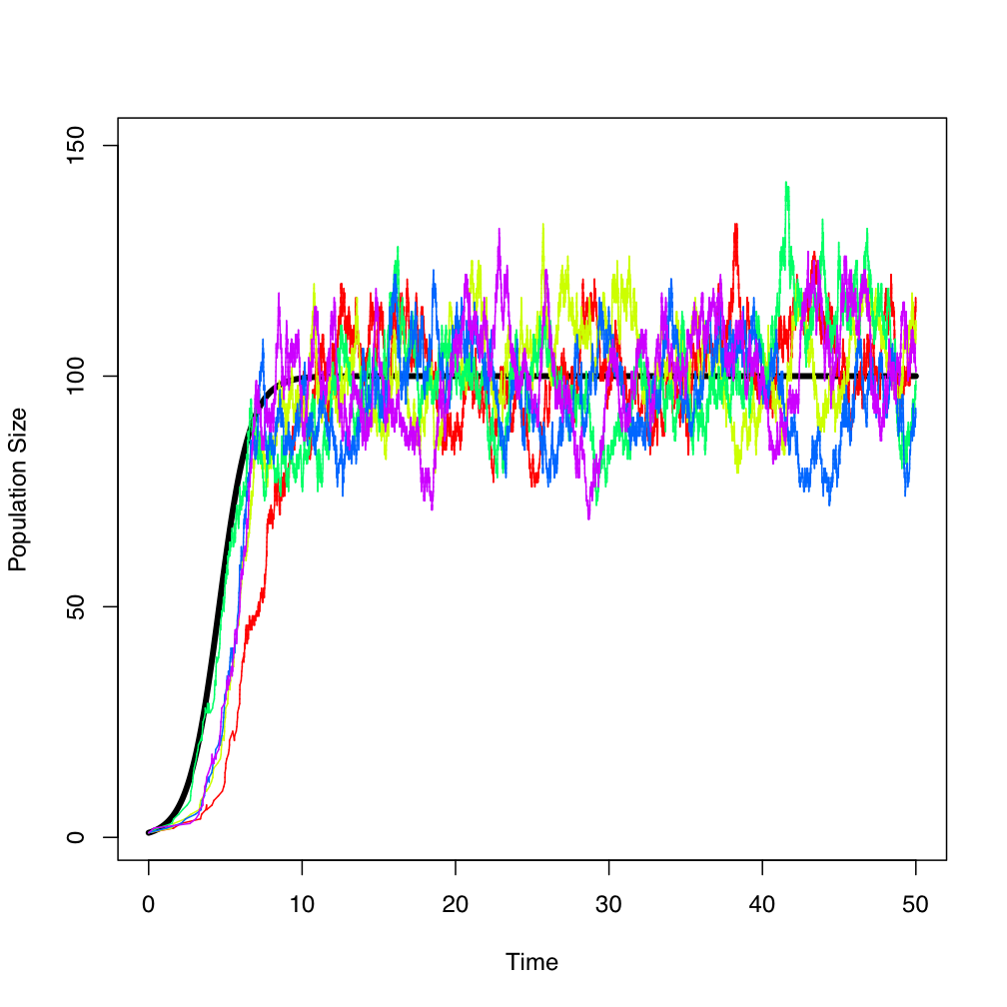
Stochasticity in the Logistic Model
Variable Delay Time in reaching carrying capacity
Fluctuations around carrying capacity

Slide 26
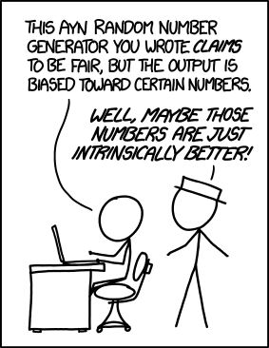
Summary
Introduced stochastic population models and the Stochastic Simulation Algorithm (SSA) for continuous time Markov processes
In large population limit dynamics of stochastic model tend towards deterministic model
Relationship between deterministic model and ensemble average of stochastic model?
http://www.xkcd.com/1277/

Slide 27
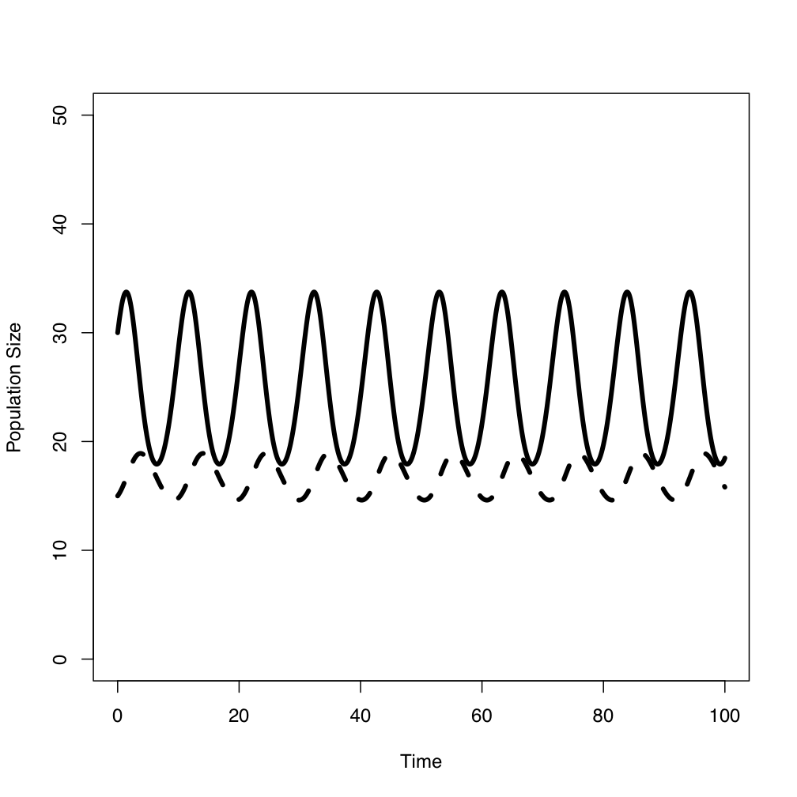
Example IV: Lokta Model
N
Two state variables
N = y[1]
P = y[2]
P

Slide 28
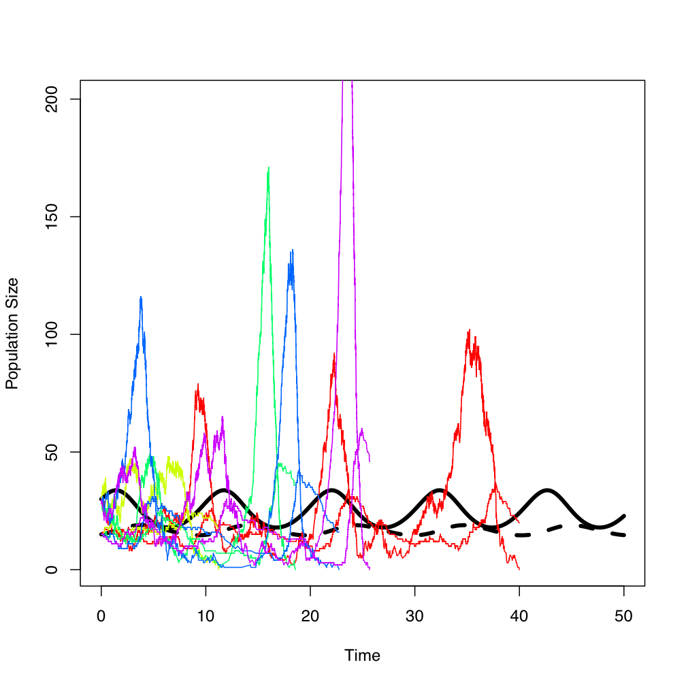
Stochastic Lokta Model
Noise can amplify cycles
Cycles rapidly terminate in extinction
Period of cycles?
Relationship between stochastic and deterministic model?

Slide 29
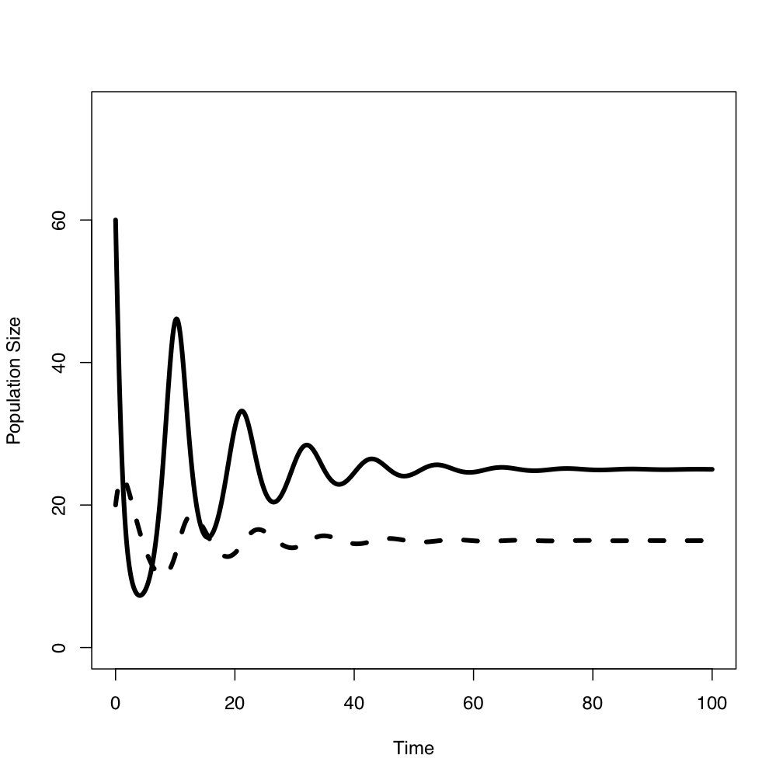
Example V: Volterra Model
Add “logistic” death term to prey population
Damped oscillations to stable fixed point

Slide 30
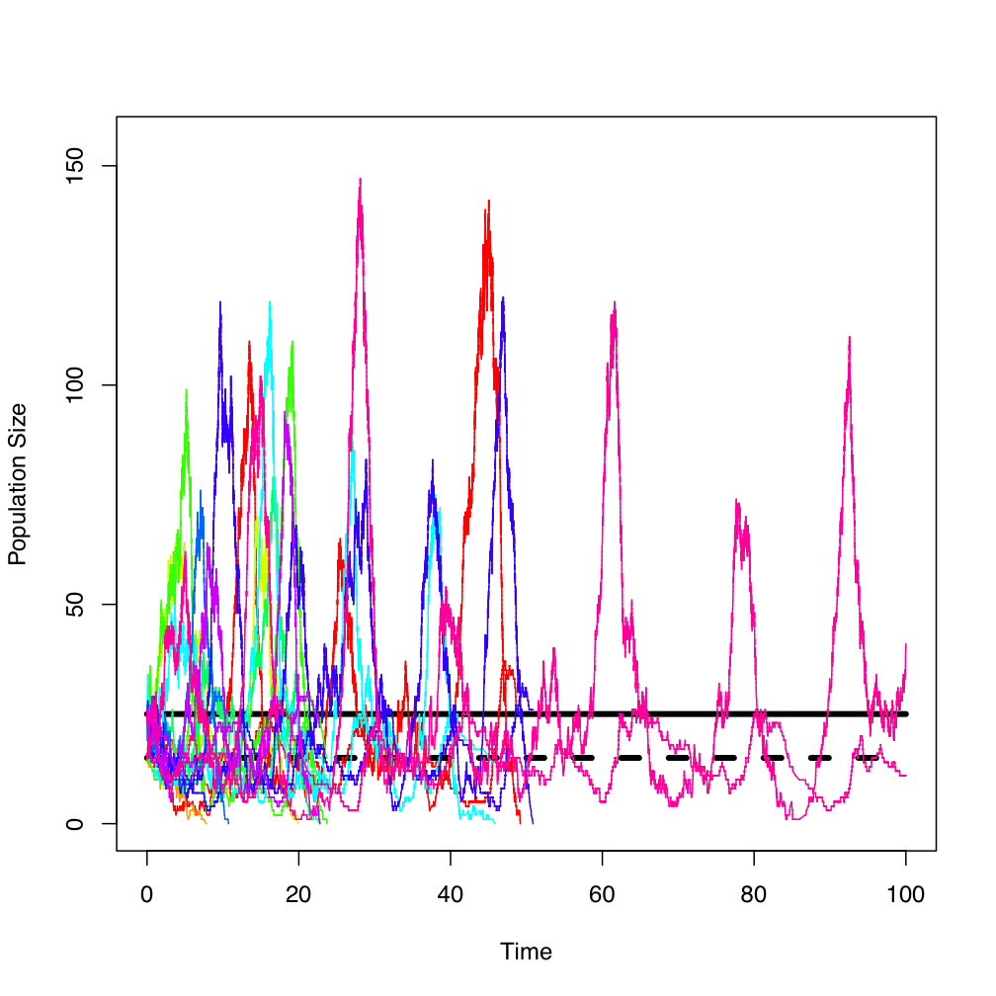
Example V: Volterra Model
Stochasticity can amplify transient dynamics to generate population cycles…

Slide 31
Example IV: Lokta Model
Deterministic
lokta_det <- function(t,y,p)
{ dy <- numeric(2)
dy[1] <- p[1] * y[1] - p[2] * y[1] * y[2]
dy[2] <- p[3] * y[1] * y[2] - p[4] * y[2]
return(list(dy)) }
oot<-lsoda(initial_state,seq(0,100,0.5),lokta_det,parms=c(1.5,0.09,0.01,0.25))
matplot(oot[,1],oot[,2:3],type='l',xlab='Time',ylab='Population Size',lwd=4,col='black')
Stochastic
require(GillespieSSA)
parameters <- c(p1=1.5, p2=0.09,p3=0.01,p4=0.25)
initial_state <- c(N=30,P=15)
rates <- c("p1*N","p2*N*P","p3*N*P","p4*P")
events <- matrix(c(+1,-1,0,0,0,0,+1,-1),nrow=2,byrow=TRUE)
out < -ssa(initial_state,rates,events,parameters,tf=100,simName="Lokta model")
ssa.plot(out)

Slide 32
Example V: Volterra Model
volterra_det <- function(t,y,p)
{
dy <- numeric(2)
dy[1] <- p[1] * y[1] - p[2] * y[1] * y[2] - p[5]*y[1]*y[1]
dy[2] <- p[3] * y[1] * y[2] - p[4] * y[2]
return(list(dy))
}
oot<-lsoda(c(30,15),seq(0,100,0.5),volterra_det,parms=c(1.5,0.09,0.01,0.25,0.006))
matplot(oot[,1],oot[,2:3],type='l',xlab='Time',ylab='Population Size',lwd=4,col='black')
Deterministic
Stochastic
require(GillespieSSA)
parameters <- c(p1=1.5, p2=0.09,p3=0.01,p4=0.25,p5=0.006)
initial_state <- c(N=30,P=15)
rates <- c("p1*N","p2*N*P","p3*N*P","p4*P","p5*N*N")
events <- matrix(c(+1,-1,0,0,-1,0,0,+1,-1,0),nrow=2,byrow=TRUE)
out <- ssa(initial_state,rates,events,parameters,tf=100,simName="Volterra model")
ssa.plot(out)

